Slide 1
Presentation 2 - Course Feedback
Vraj Daniel Nate Feni

Slide 2
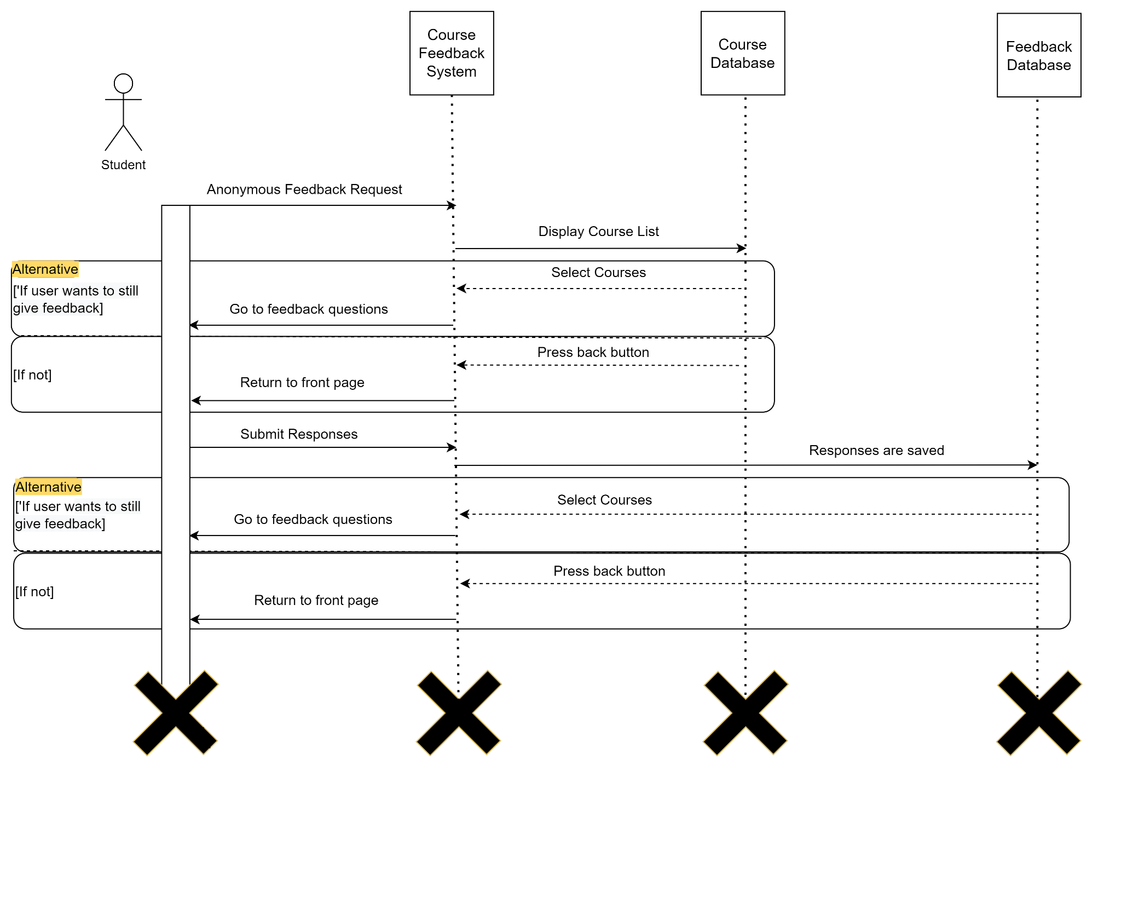
Uml Diagram

Slide 3
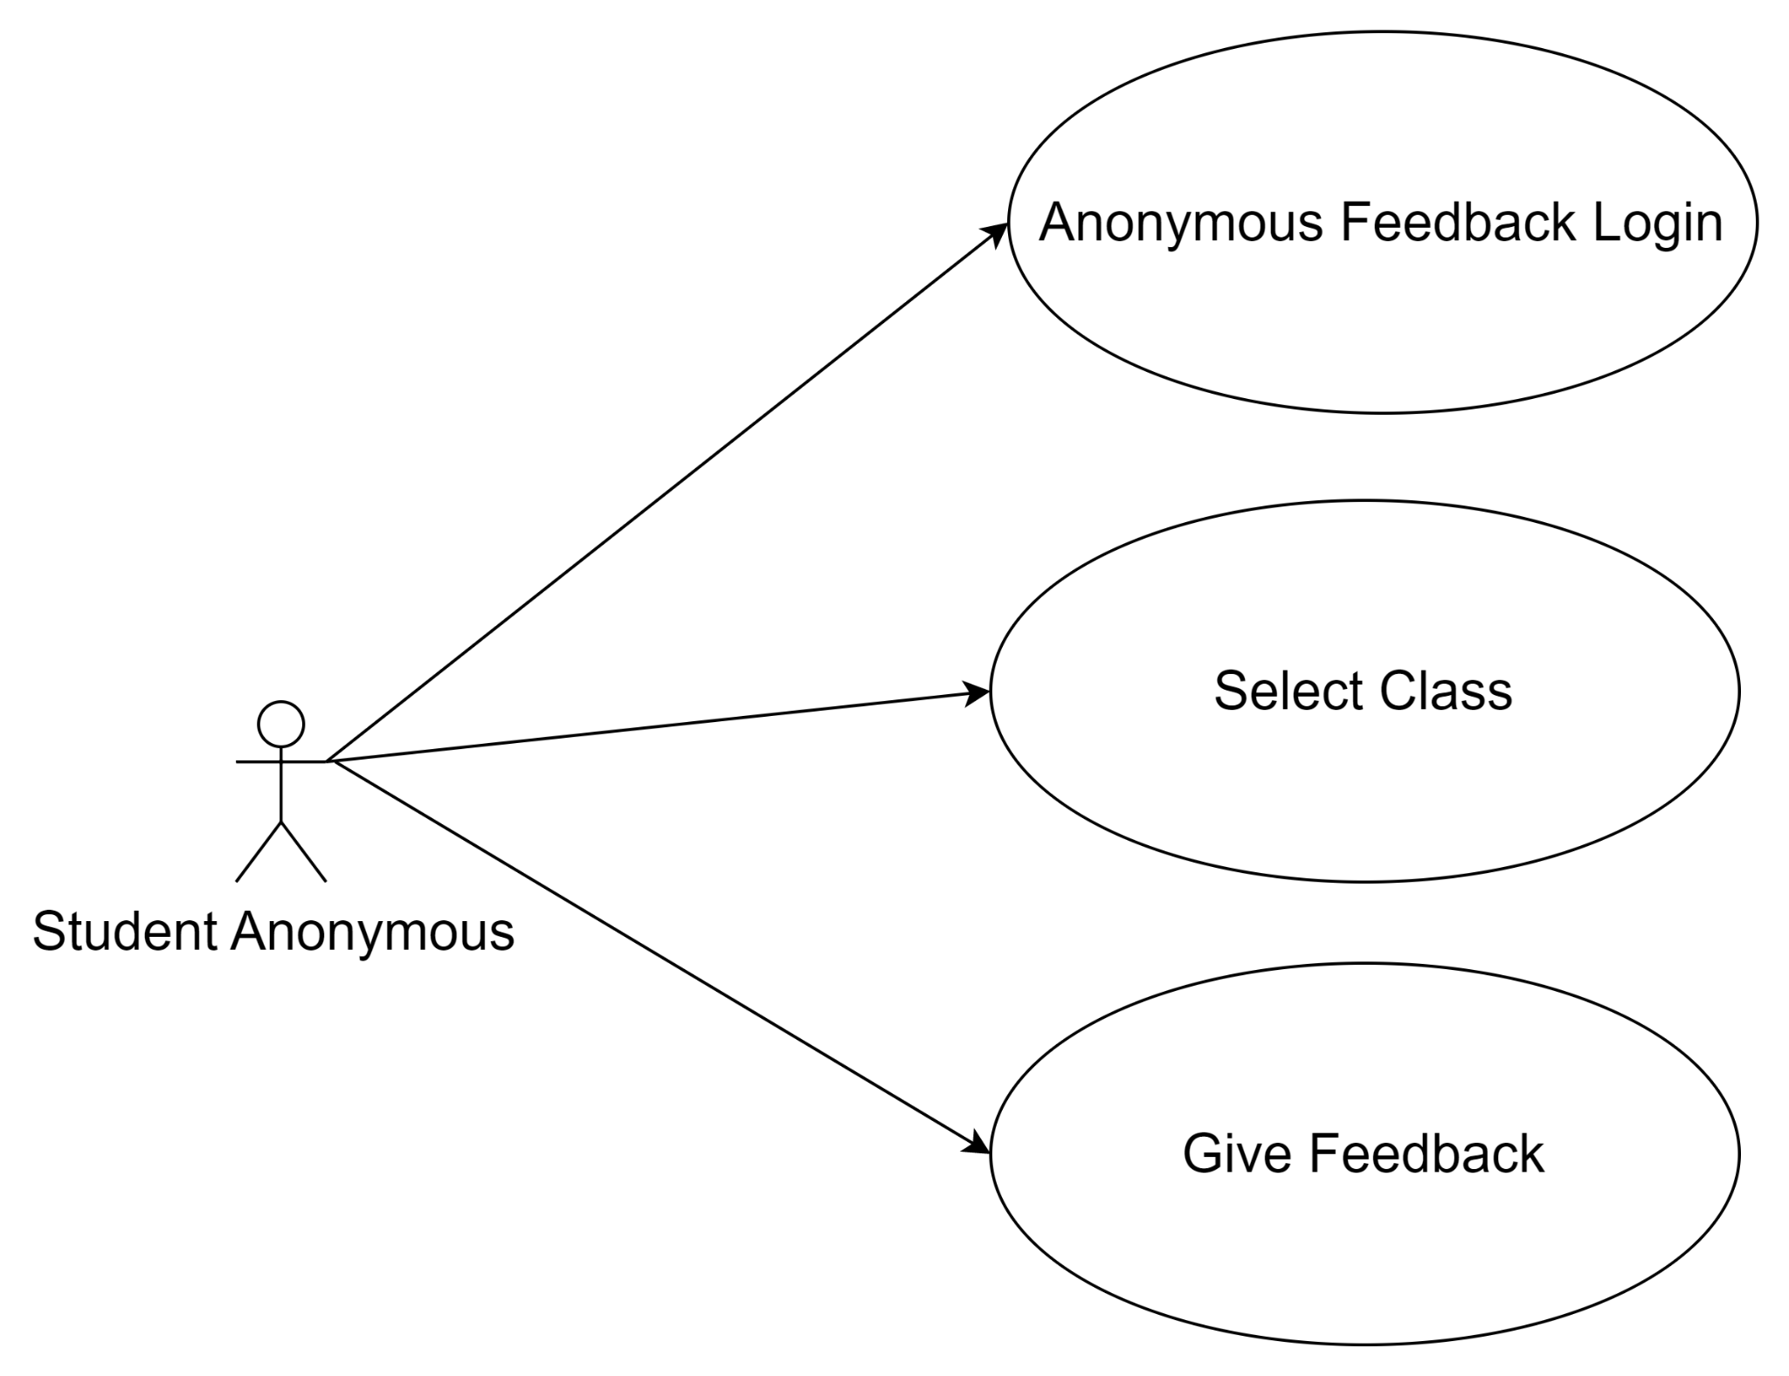
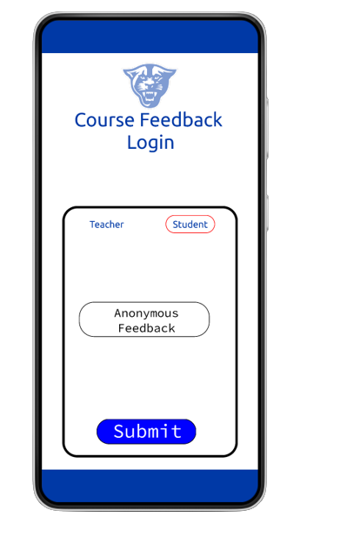
Use Case 1

Slide 4
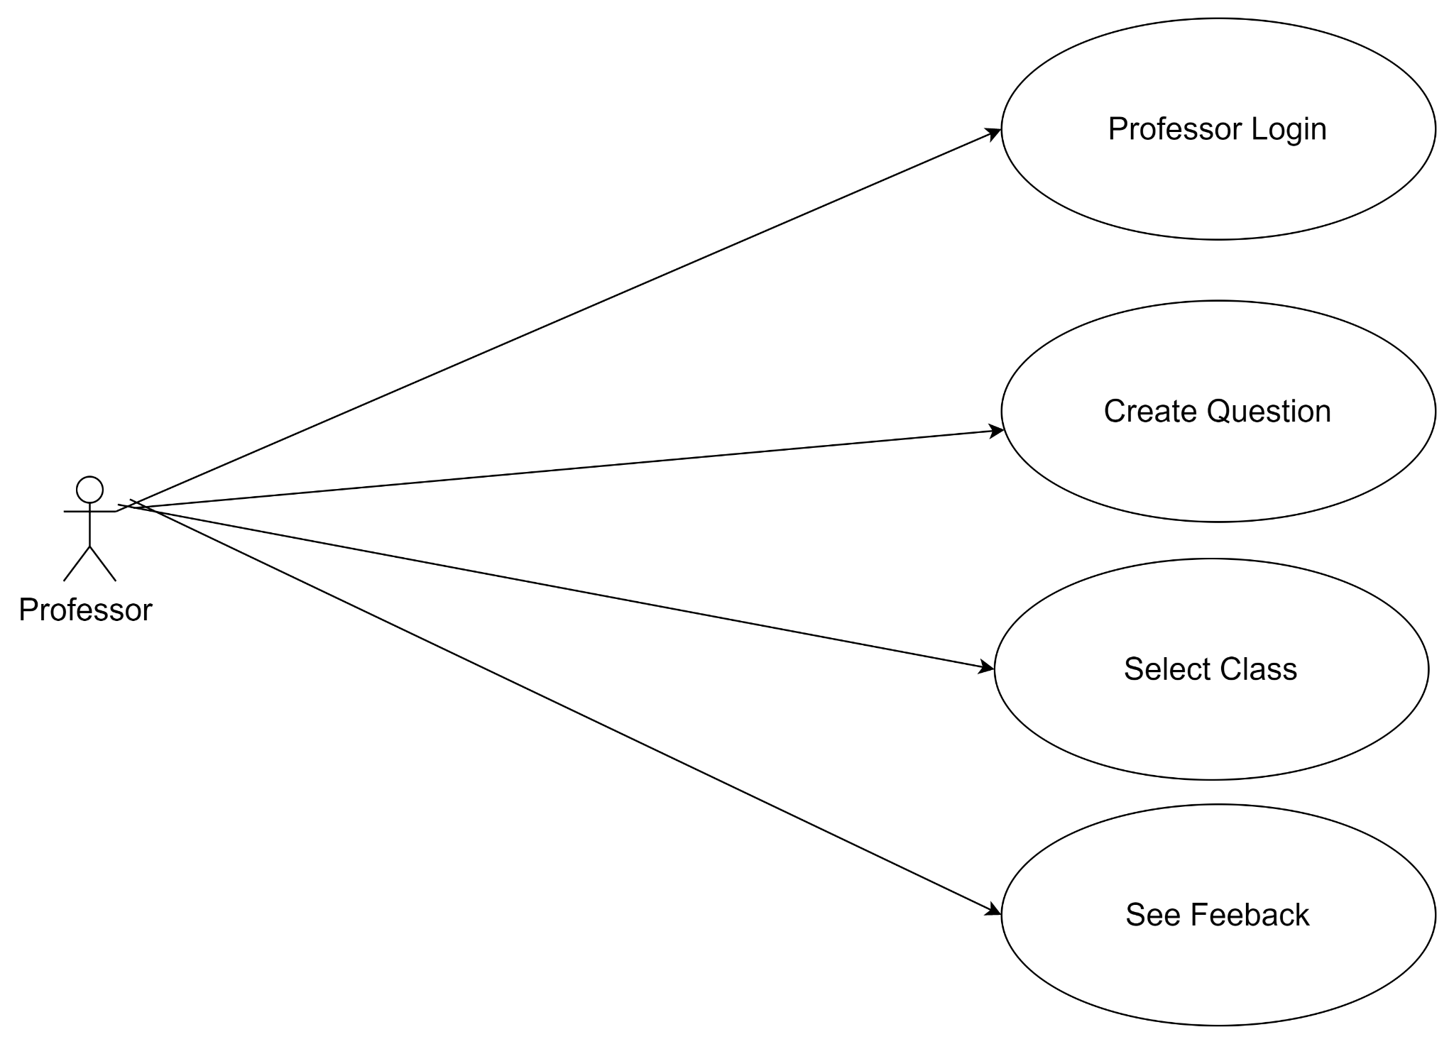
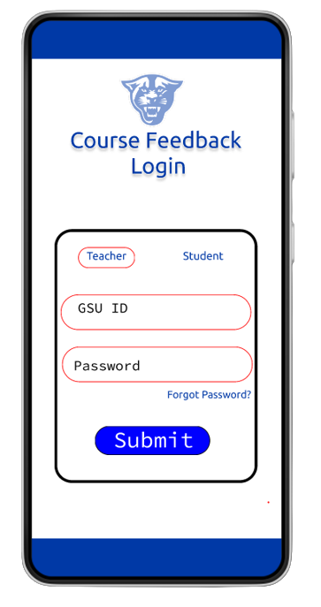
Use Case 2

Slide 5
Test Case 1
Scenario: The student is very upset with their grade for the course. The student decides to leave vulgar words to express their anger.
Input: The text written for the open response.
Test: Inputs using profane language.
Output: An output that says “Response contains vulgar language. Disqualified.”

Slide 6
Test Case 2
Scenario: Student wants to submit several instances of feedback for the exact same instance of a course.
Input: Duplicate feedback submissions.
Test: How will the system process duplicate submissions.
Output: The system should inform the anonymous user that they already submitted feedback for the course.

Slide 7
Thank You
Any Feedback?

